Slide 1
Eternal redemption
Hebrews:10 vs 10

Slide 2
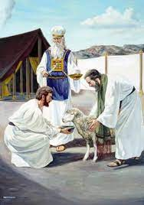
Leviticus:4 vs 1-10
The sinner comes with a lamb without blemish .The sinner lays his hands on the head of the lamb and transfers his or her sin onto the lamb. The lamb is slaughtered. Because the wages of sin is death.

Slide 3
v

Slide 4
Hebrews:10 vs. 17-18
Verse 17
Then he adds:“ their sins and lawless acts I will remember no more.”
Verse 18
And where these have been forgiven, sacrifice for sin is no longer necessary.

Slide 5
NOW YOU ARE SAVED FROM SIN
THANK you

